Slide 1
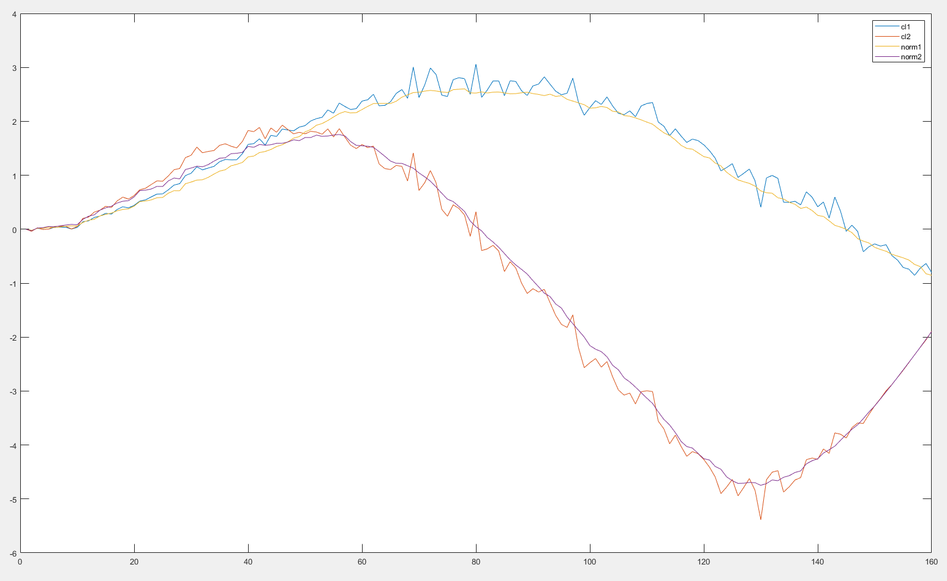
cartpole
cdc2017 lqg
current D!=0
Batch=60
noise=20%
Averaged over 500

Slide 2
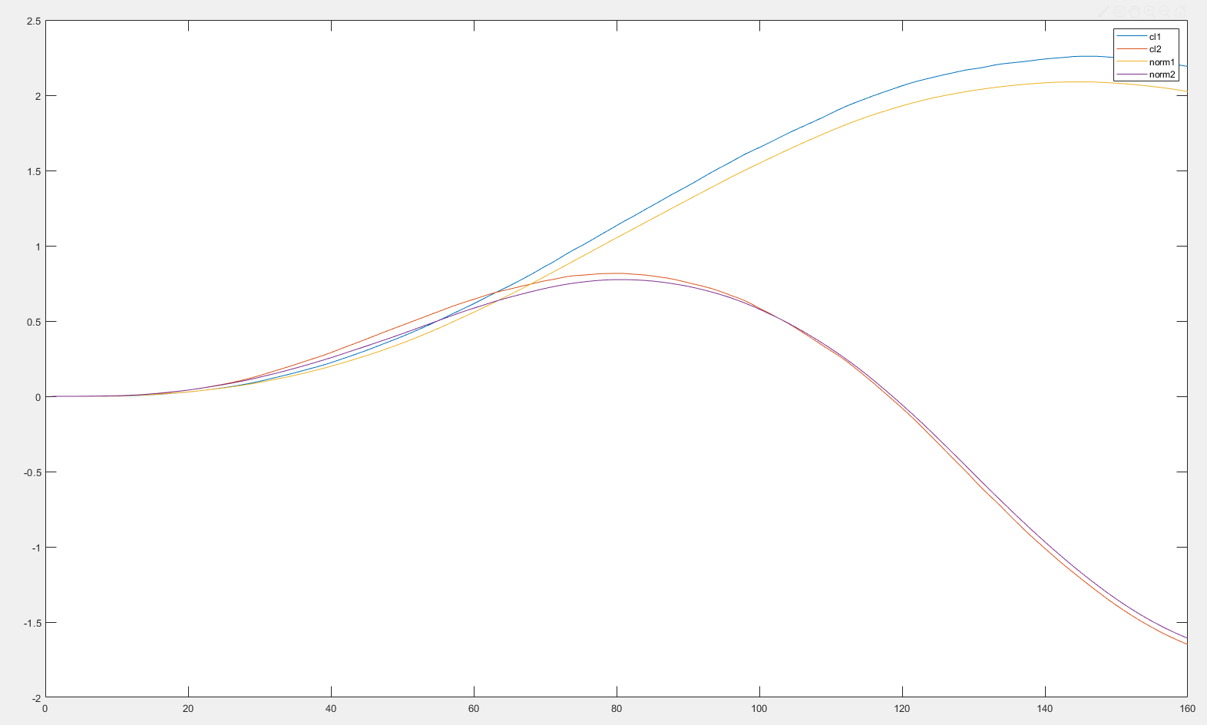
cartpole
cdc2017 lqg
current D!=0
Batch=60
noise=20%
Averaged over 500

Slide 3
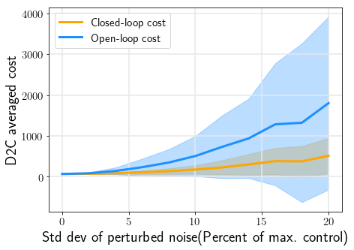
Cartpole
Batch=60
Averaged over 400

Slide 4
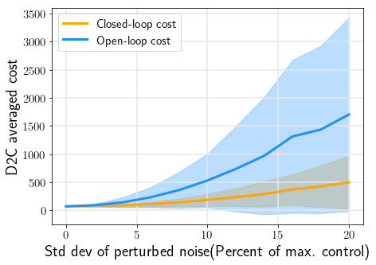
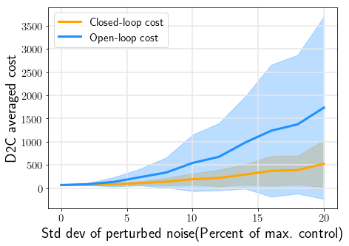
Cartpole
Batch=260
Averaged over 400

Slide 5
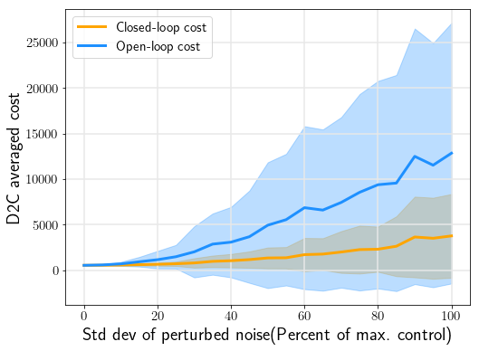
Pendulum
Batch=20
Averaged over 400

Slide 6
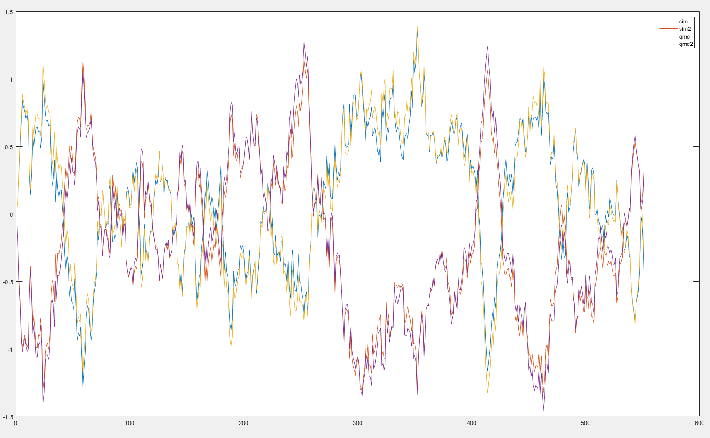
Swimmer3
Batch=110
Averaged over 1
dt=0.001s
Noise=10%
y_sim vs y_qmc
Index=9:10

Slide 7
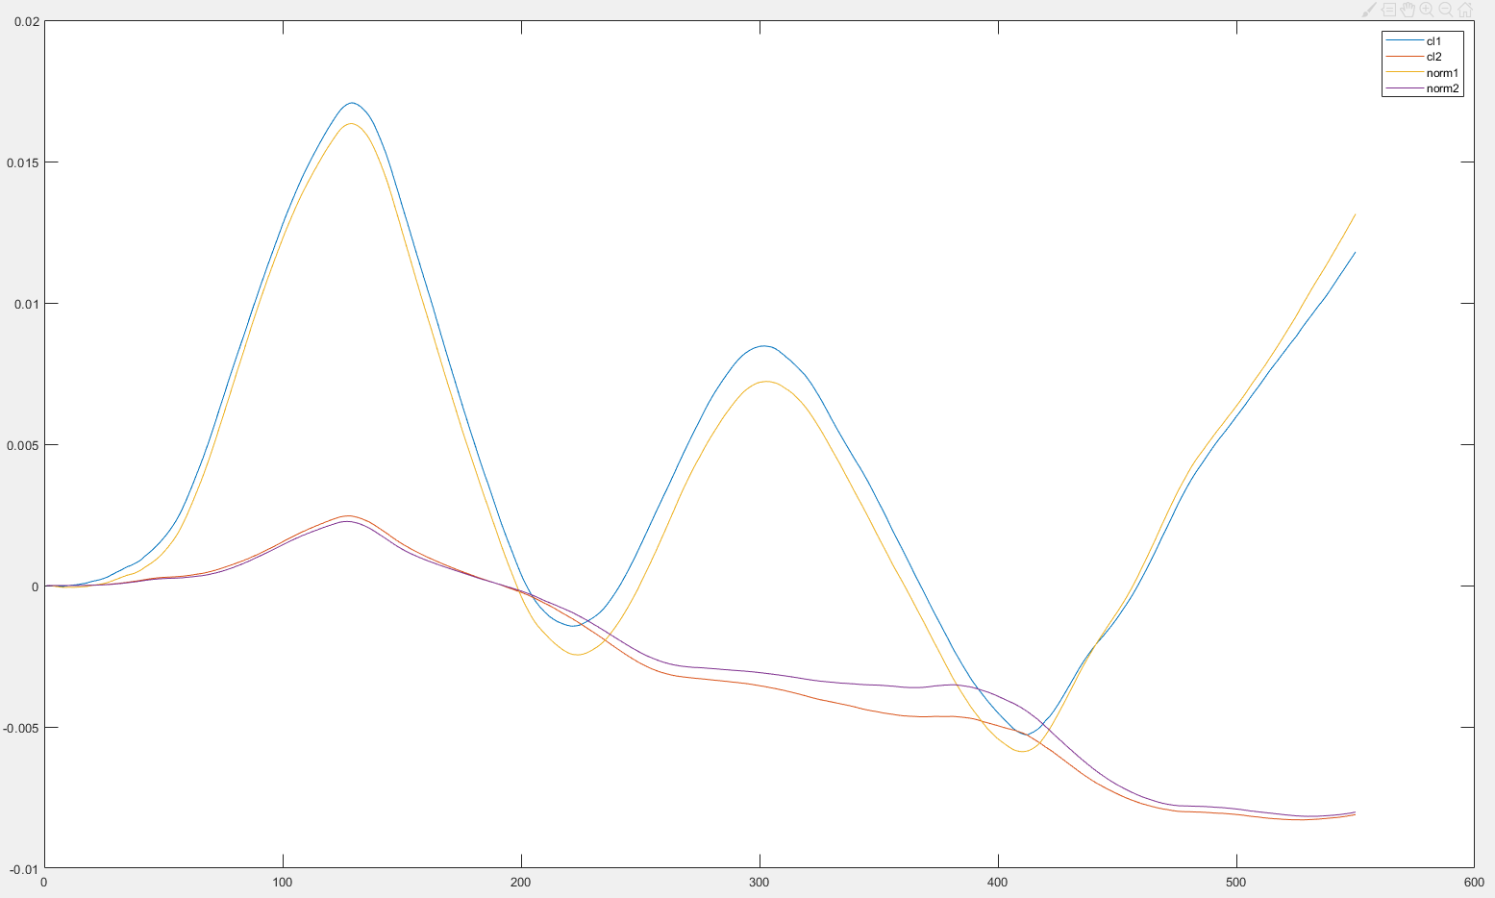
Swimmer3
Batch=110
Averaged over 500
dt=0.001s
Noise=10%
Closedloop
Y(1:2)

Slide 8
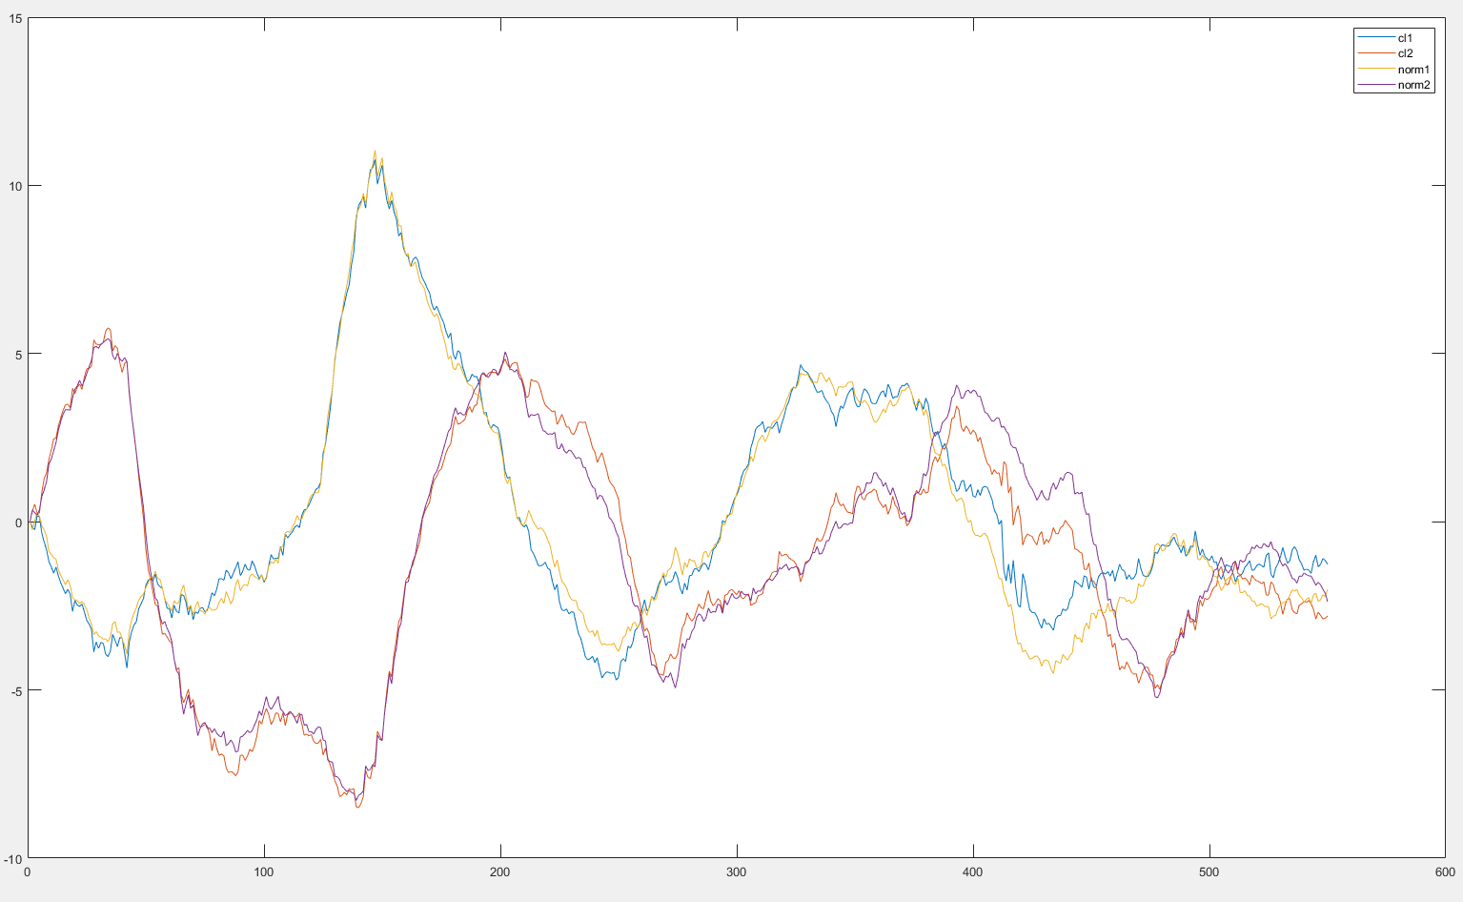
Swimmer3
Batch=110
Averaged over 500
dt=0.001s
Noise=10%
Closedloop
Y(9:10)

Slide 9
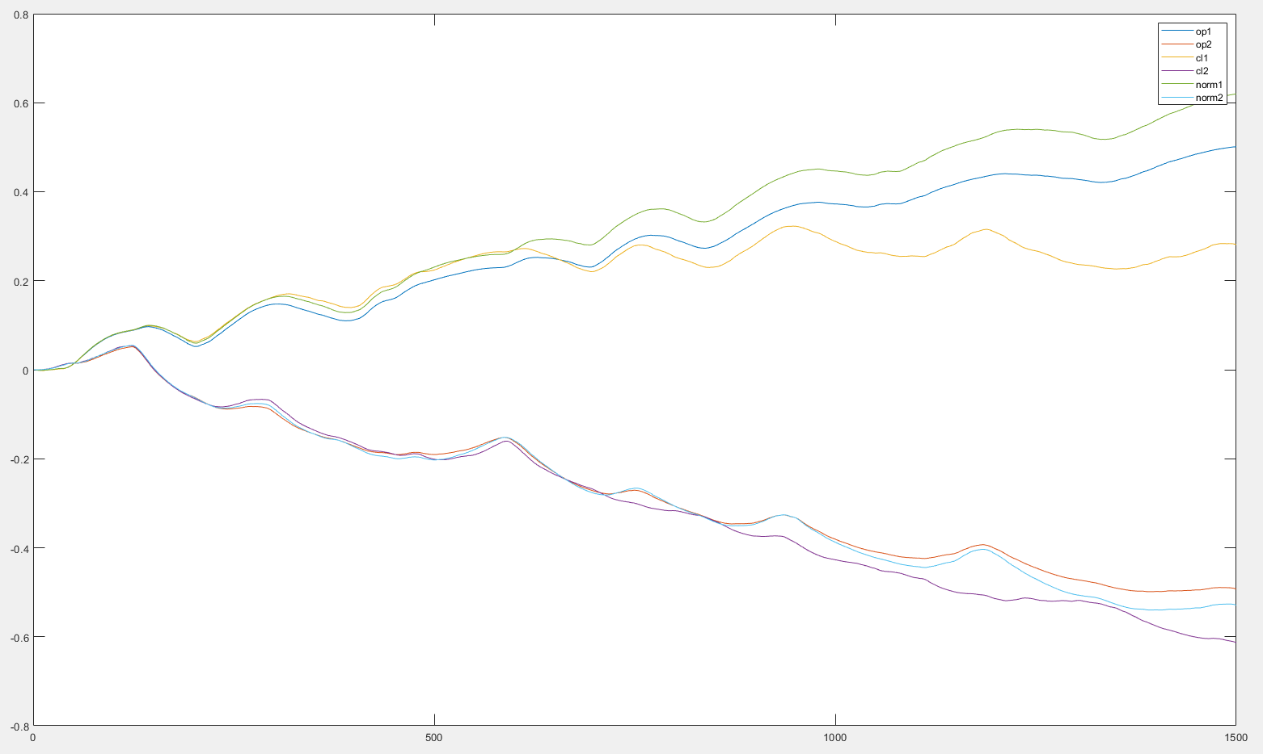
Swimmer3
Batch=1500
Averaged over 1
dt=0.005s
Noise=10%
Closedloop
Y(1:2)

Slide 10
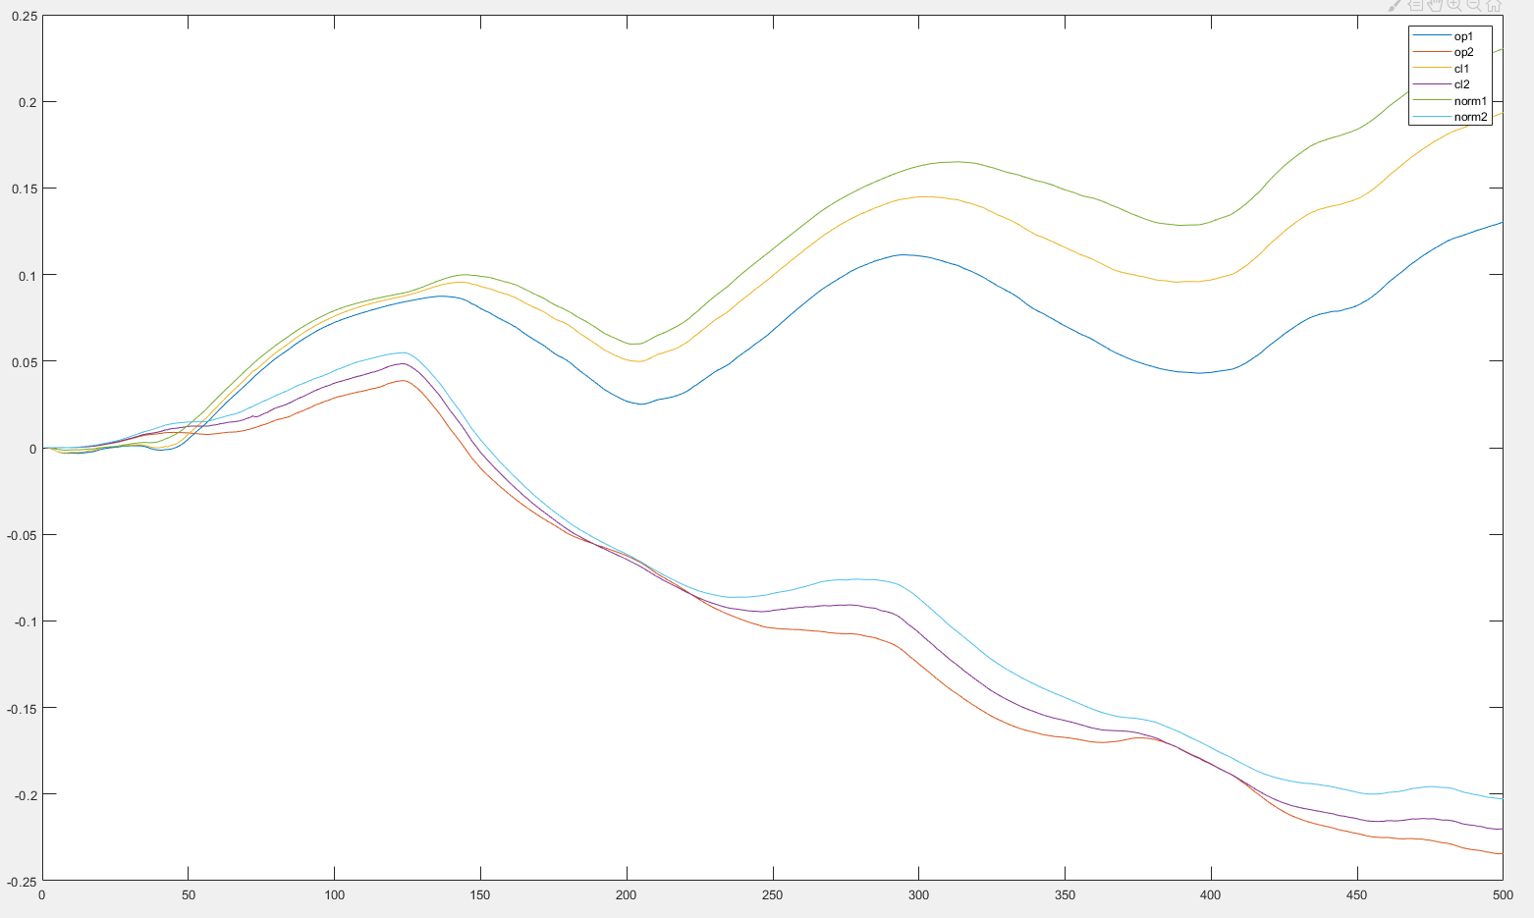
Swimmer3
Batch=500
Averaged over 1
dt=0.005s
Noise=10%
Closedloop
Y(1:2)

Slide 11
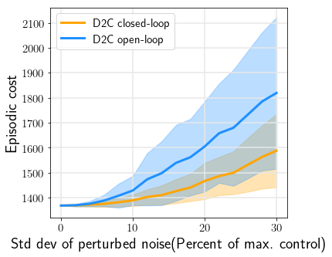
Swimmer3
First 500 steps
Averaged over 400
dt=0.005s
Closedloop vs openloop

Slide 12
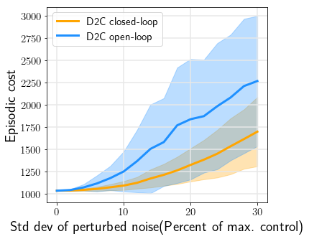
Swimmer3
First 1300 steps
Averaged over 400
dt=0.005s
Closedloop vs openloop

Slide 13
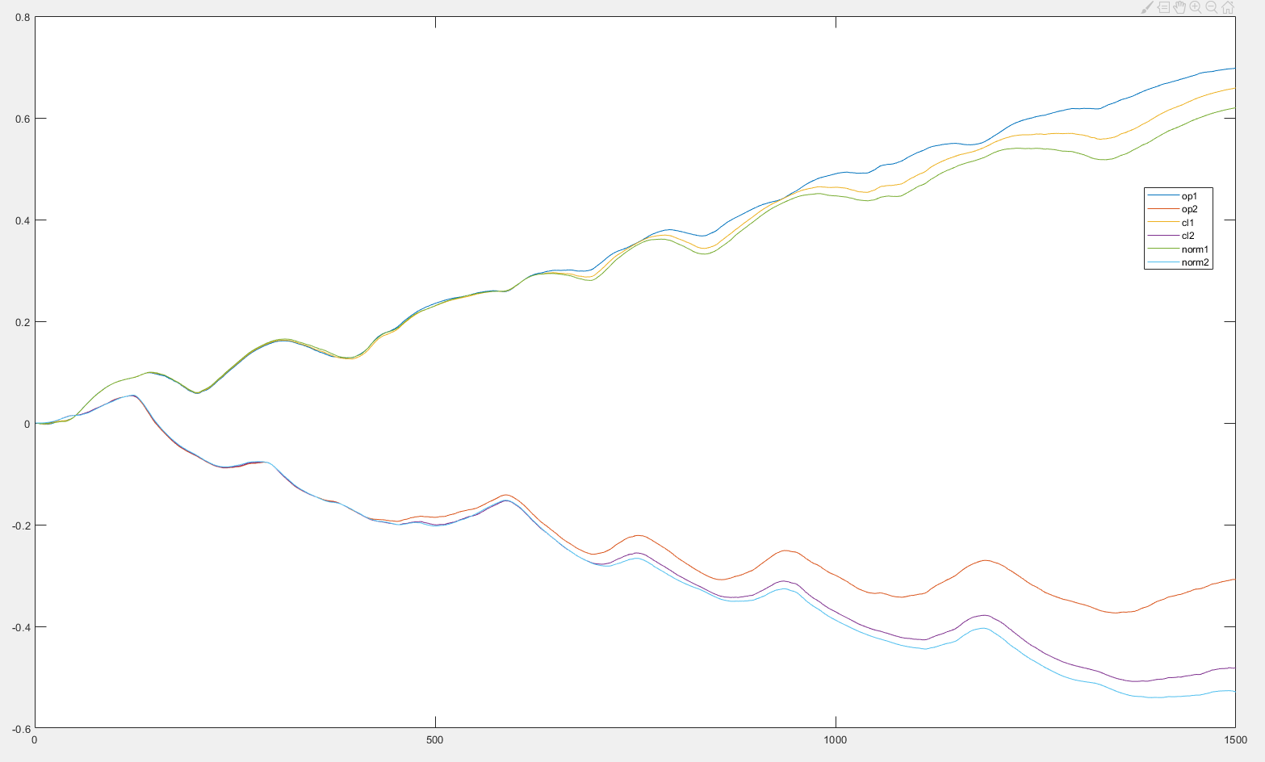
Swimmer3
Batch=770
Zero init
Averaged over 1
dt=0.005s
Noise=10%
Closedloop
Y(1:2)

Slide 14
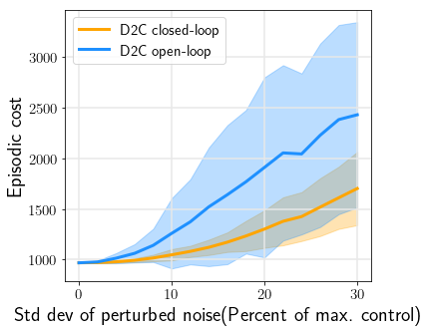
Swimmer3
1500 steps
Zero init
Averaged over 400
dt=0.005s
Closedloop vs openloop

Slide 15
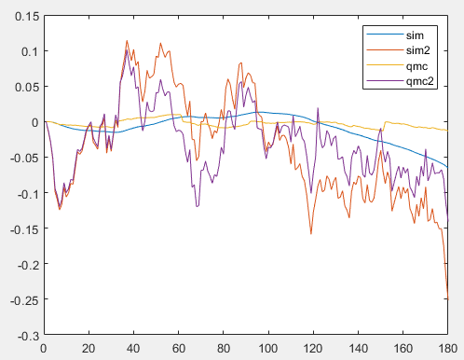
Pendulum
Batch=30
Zero init
Averaged over 1
dt=0.01s
Noise=10%
Sim vs qmc
Y(1:2)
Pert_noise=0.1umax

Slide 16
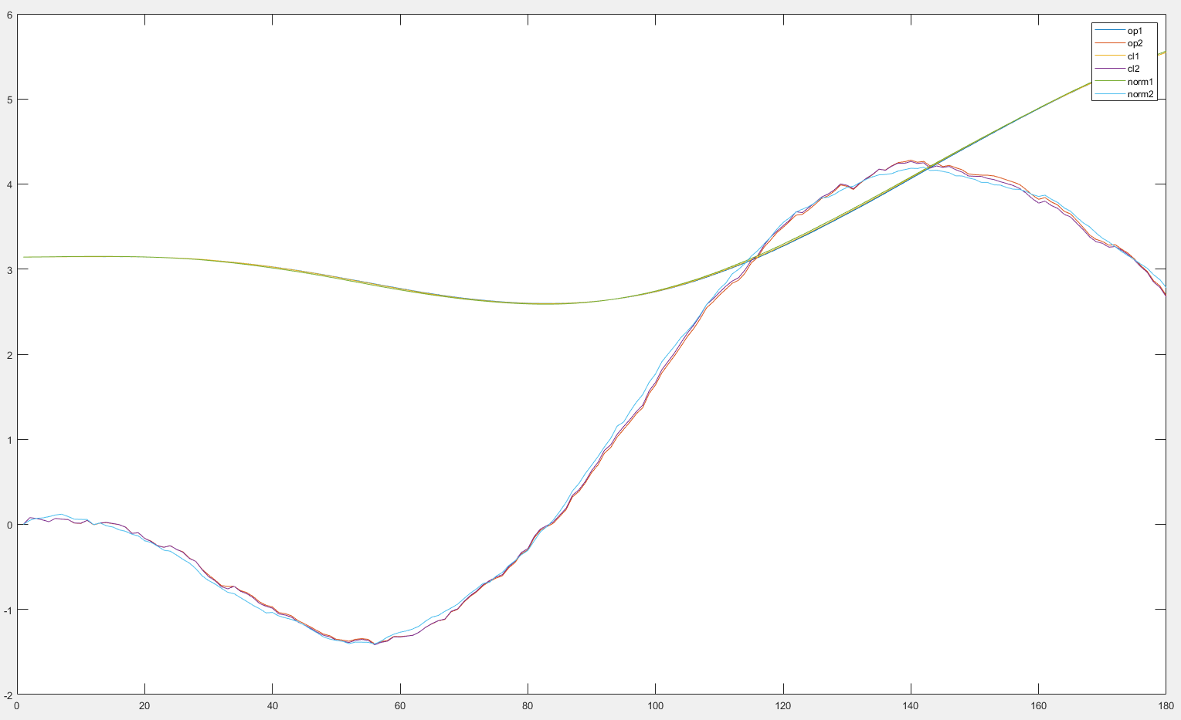
Pendulum
Batch=30
Zero init
Averaged over 1
dt=0.01s
Noise=10%
closedloop
Y(1:2)
Pert_noise=0.1umax

Slide 17
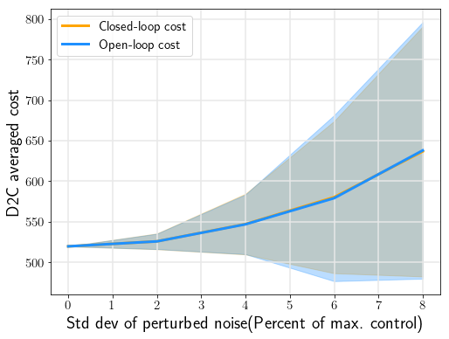
Pendulum
Batch=30
Zero init
Averaged over 400
dt=0.01s
Closedloop vs openloop
Pert_noise=0.1umax

Slide 18
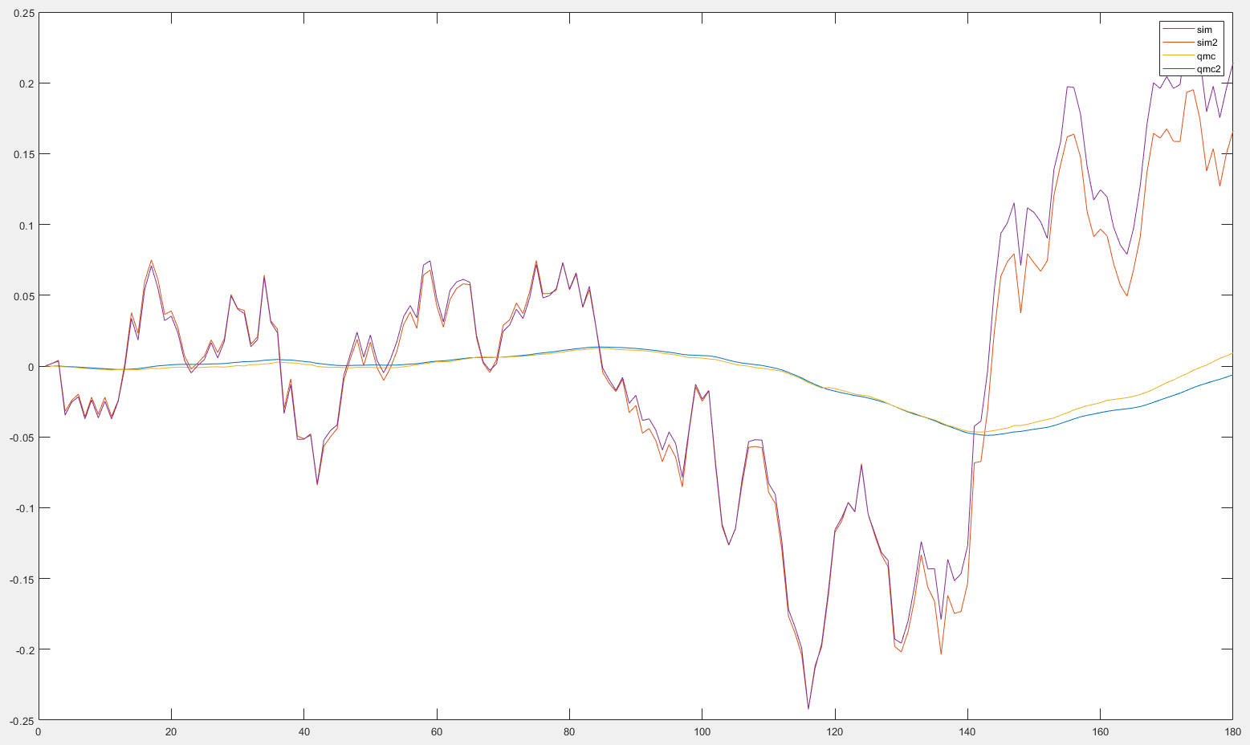
Pendulum
Batch=30
nonzero init
Averaged over 1
dt=0.01s
Noise=10%
Sim vs qmc
Y(1:2)
Sysid Pert_noise=0.1umax

Slide 19
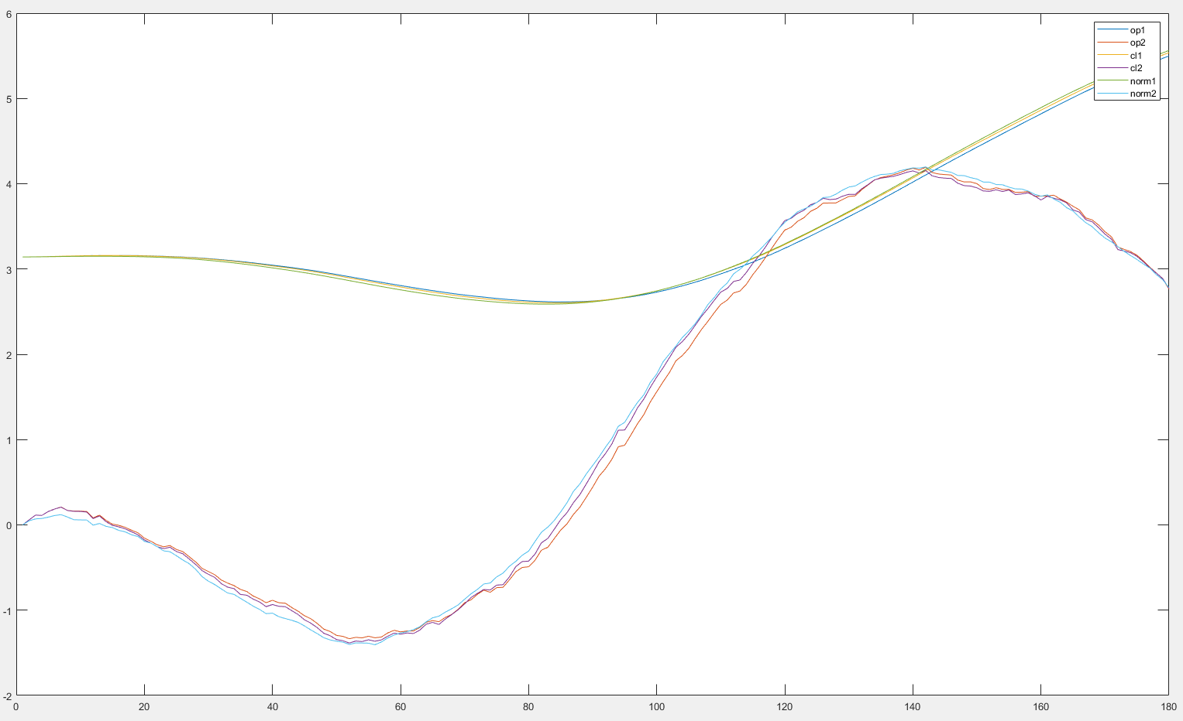
Pendulum
Batch=30
nonzero init
Averaged over 1
dt=0.01s
Noise=10%
closedloop
Y(1:2)
Sysid Pert_noise=0.1umax

Slide 20
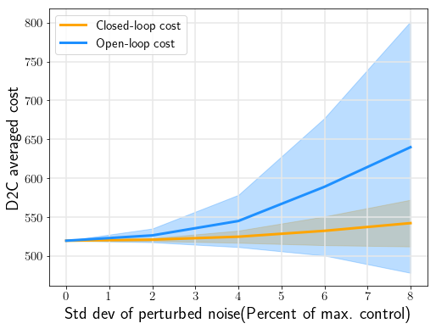
Pendulum
Batch=30
nonzero init
Averaged over 400
dt=0.01s
Closedloop vs openloop
Sysid Pert_noise=0.1umax

Slide 21
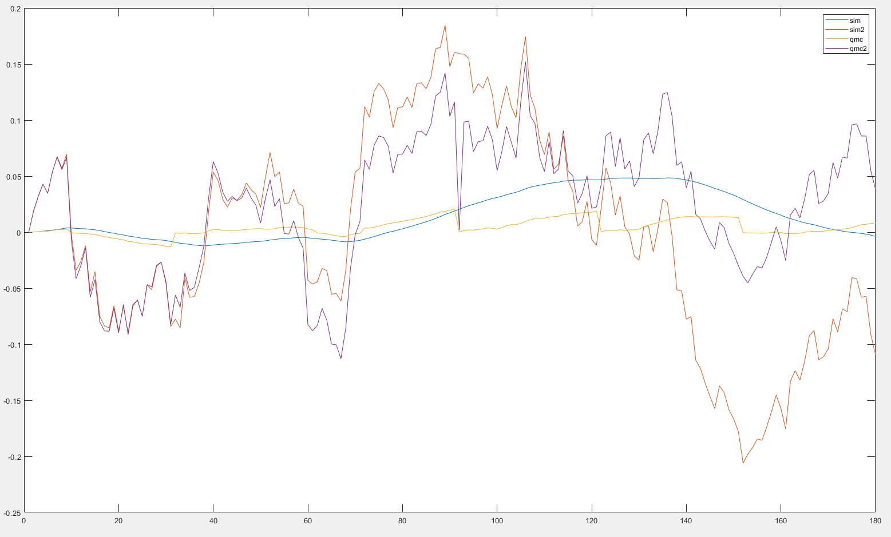
Pendulum
Batch=30
zero init
Averaged over 1
dt=0.01s
Noise=10%
Sim vs qmc
Y(1:2)
Pert_noise=0.5umax

Slide 22
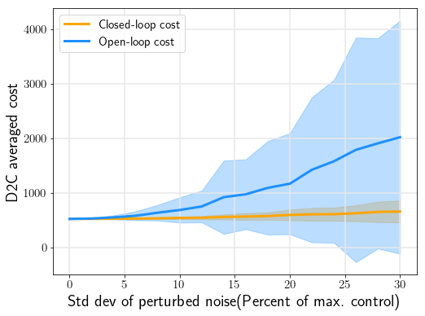
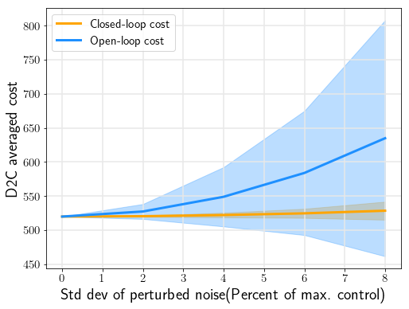
Pendulum
Batch=30
zero init
Averaged over 400
dt=0.01s
Closedloop vs openloop
Pert_noise=0.5umax

Slide 23
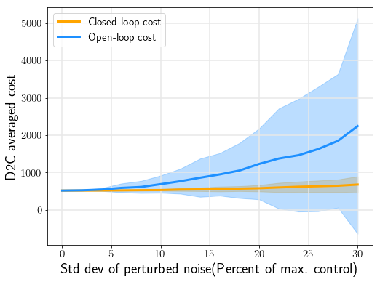
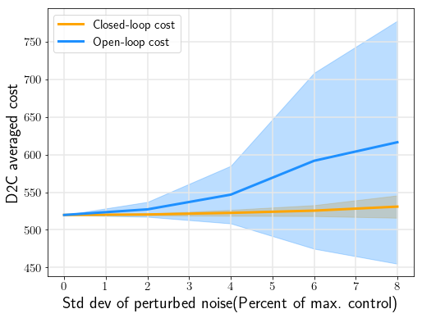
Pendulum
Batch=30
nonzero init
Averaged over 400
dt=0.01s
Closedloop vs openloop
Pert_noise=0.5umax

Slide 24
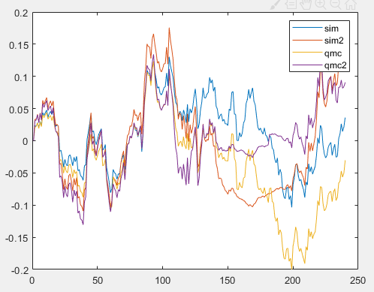
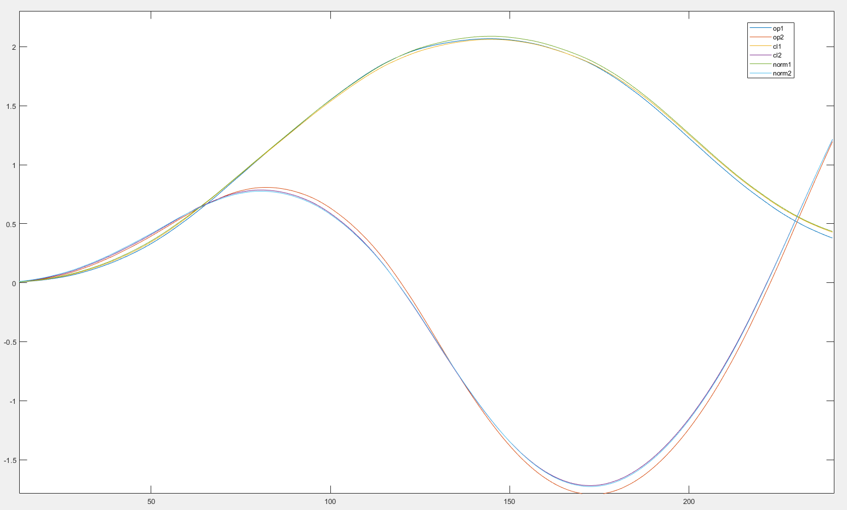
Cartpole
Batch=60
zero init
Averaged over 1
dt=0.01s
Noise=10%
Sim vs qmc
Y(1:2)
Sysid Pert_noise=0.5umax

Slide 25
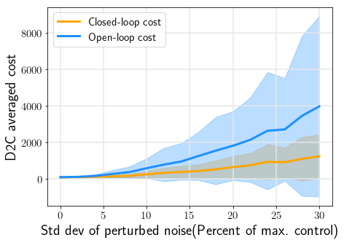
Cartpole
Batch=60
zero init
Averaged over 400
dt=0.01s
Closedloop vs openloop
Sysid Pert_noise=0.5umax

Slide 26
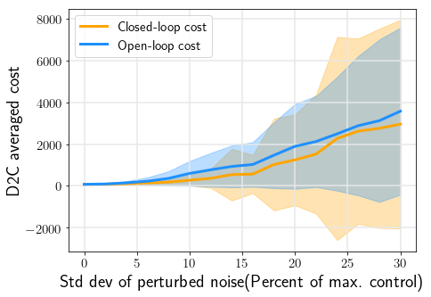
Cartpole
Batch=20
zero init
Averaged over 400
dt=0.01s
Closedloop vs openloop
Sysid Pert_noise=0.5umax

Slide 27
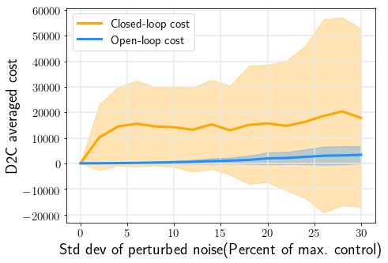
Cartpole
Batch=10
zero init
Averaged over 400
dt=0.01s
Closedloop vs openloop
Sysid Pert_noise=0.5umax

Slide 28
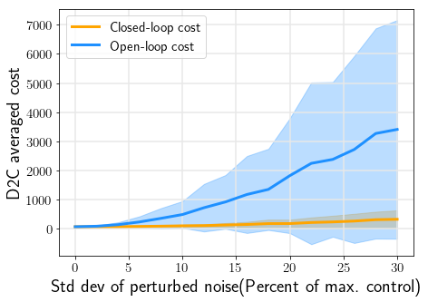
Cartpole
Batch=20
Init=0.1
Averaged over 400
dt=0.01s
Closedloop vs openloop
Sysid Pert_noise=0.5umax

Slide 29
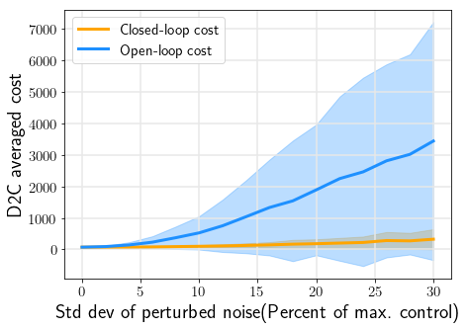
Cartpole
Batch=10
Init=0.1
Averaged over 400
dt=0.01s
Closedloop vs openloop
Sysid Pert_noise=0.5umax

Slide 30
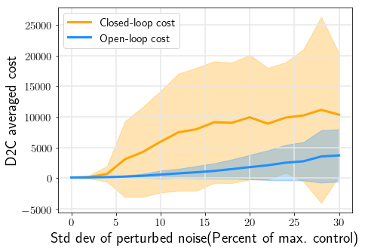
Cartpole
Batch=10
Init=0.001
Averaged over 400
dt=0.01s
Closedloop vs openloop
Sysid Pert_noise=0.5umax

Slide 31
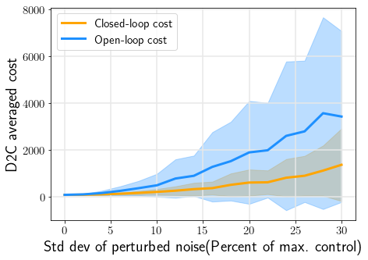
Cartpole
Batch=60
zero init
Averaged over 400
dt=0.01s
Closedloop vs openloop
Sysid Pert_noise=0.5umax
Sysid trialnum=200

Slide 32
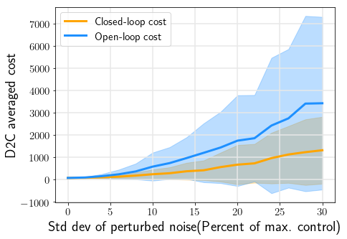
Cartpole
Batch=60
Init=0.1
Averaged over 400
dt=0.01s
Closedloop vs openloop
Sysid Pert_noise=0.5umax
Sysid trialnum=200

Slide 33
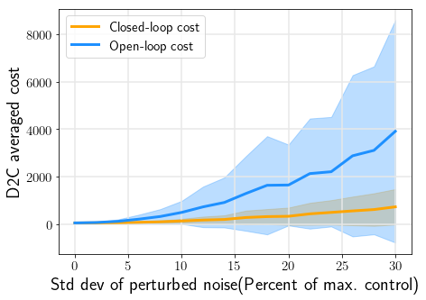
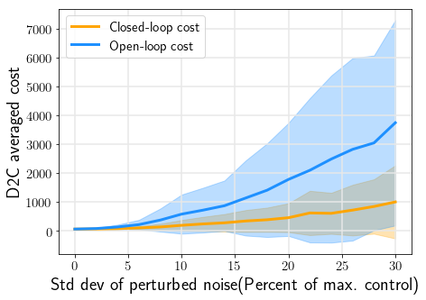
Cartpole
Batch=60
Init=0.2
Averaged over 400
dt=0.01s
Closedloop vs openloop
Sysid Pert_noise=0.5umax
Sysid trialnum=200

Slide 34
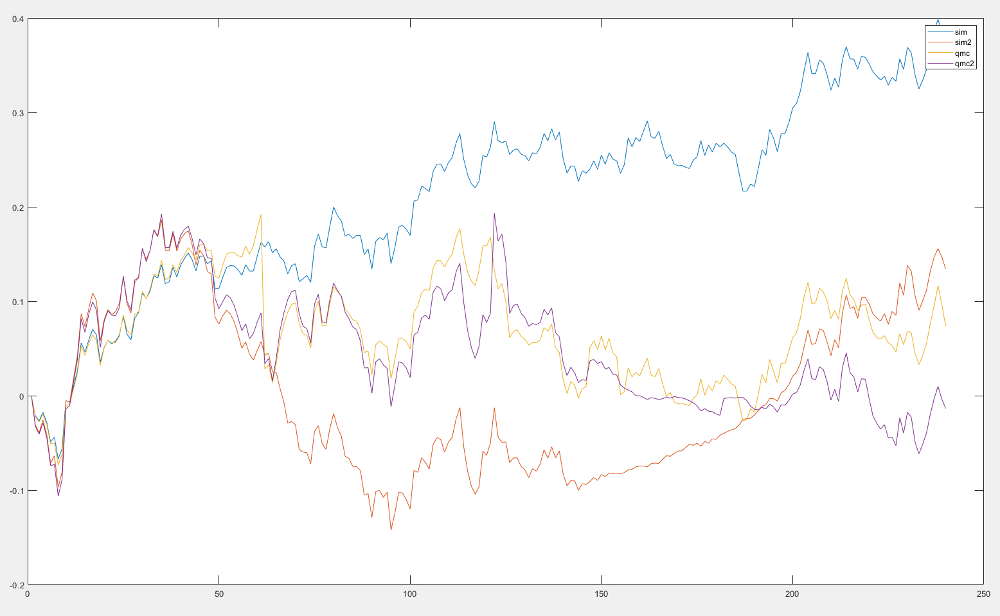
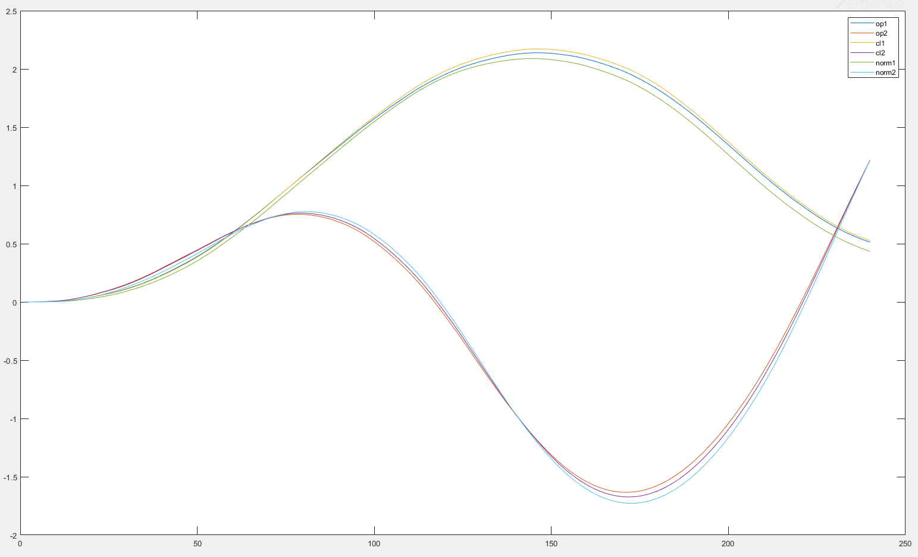
Cartpole
Batch=60
zero init
Averaged over 1
dt=0.01s
Noise=10%
Sim vs qmc
Y(1:2)
Sysid Pert_noise=0.12umax

Slide 35
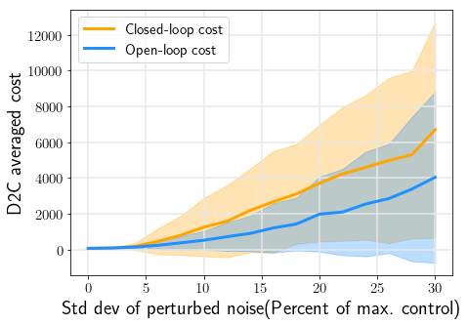
Cartpole
Batch=60
zero init
Averaged over 400
dt=0.01s
Closedloop vs openloop
Sysid Pert_noise=0.12umax

Slide 36
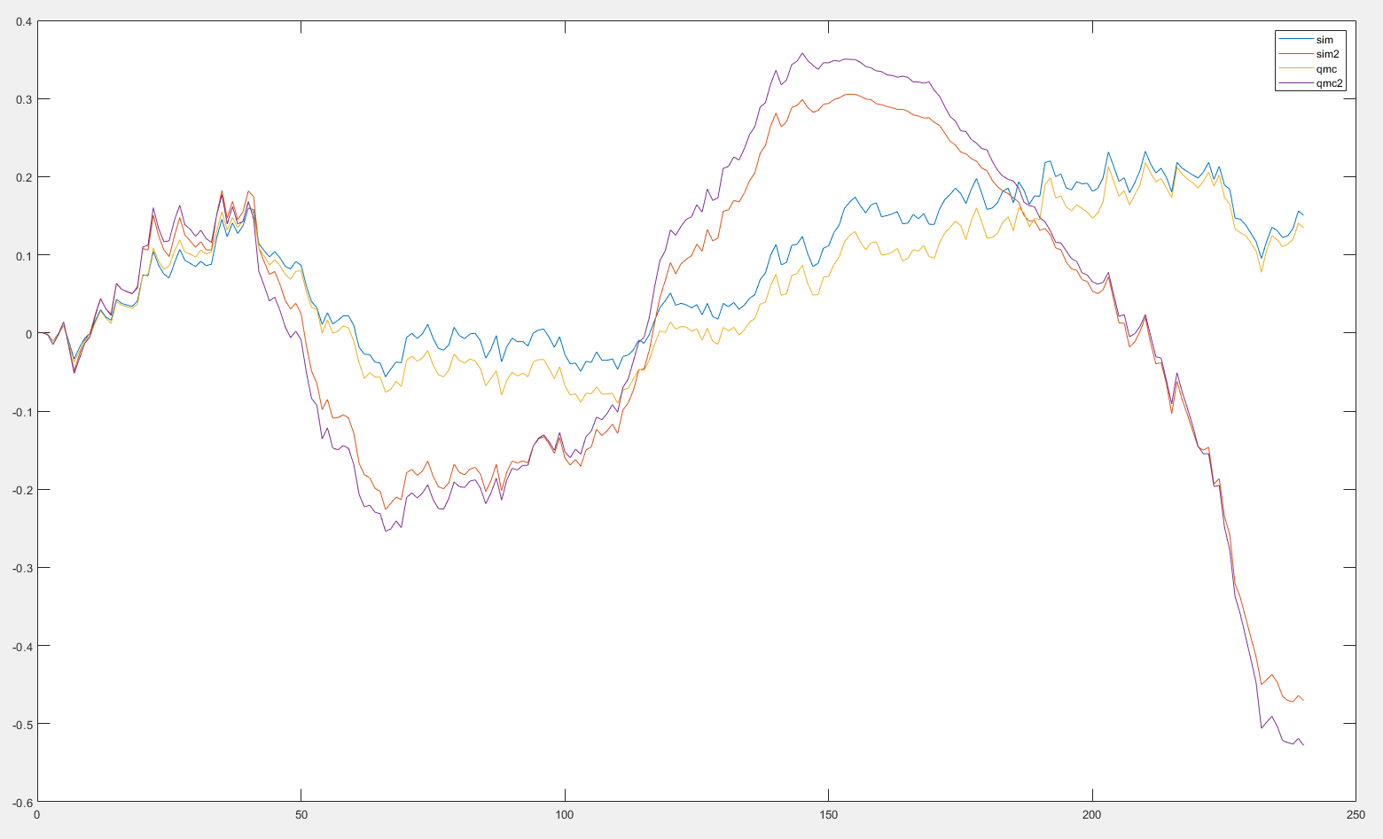
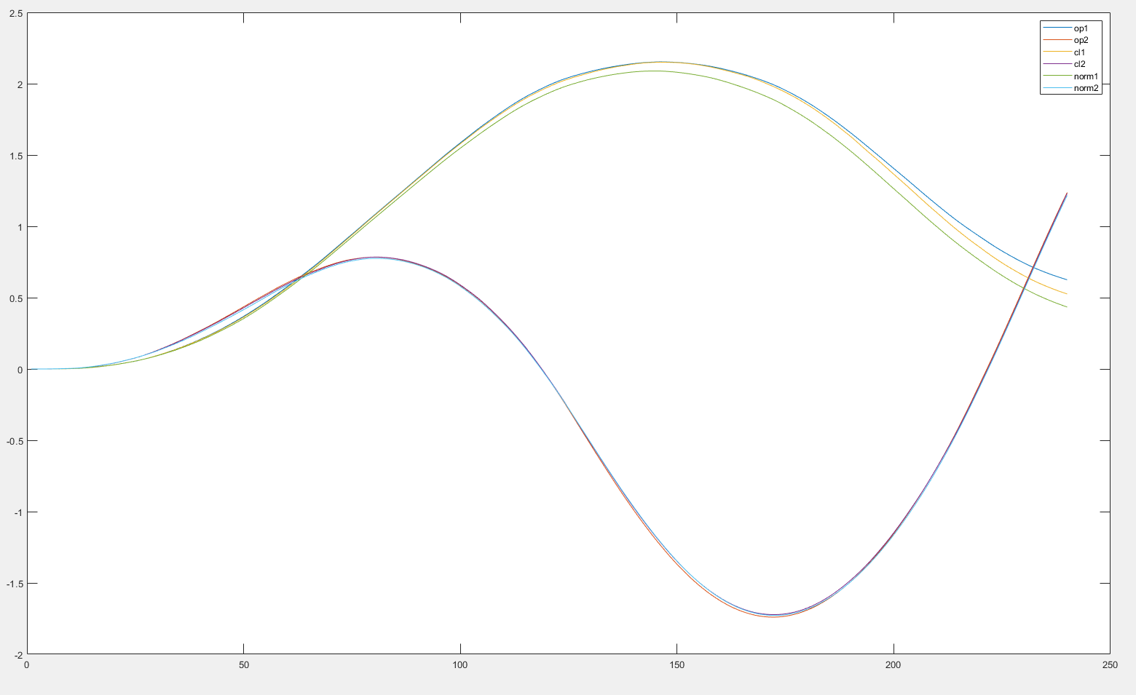
Cartpole
Batch=60
nonzero init
Averaged over 1
dt=0.01s
Noise=10%
Sim vs qmc
Y(1:2)
Sysid Pert_noise=0.12umax

Slide 37
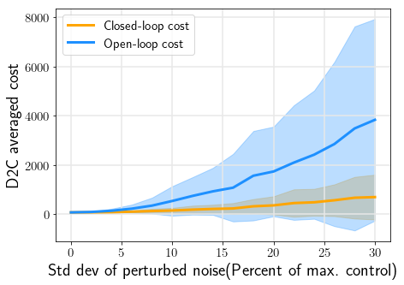
Cartpole
Batch=60
nonzero init
Averaged over 400
dt=0.01s
Closedloop vs openloop
Sysid Pert_noise=0.12umax

Slide 38
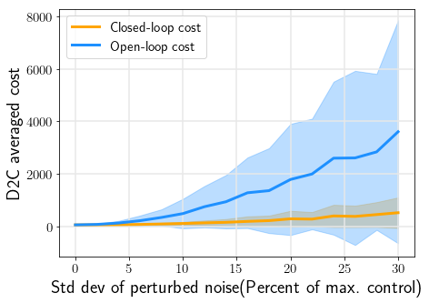
Cartpole
Batch=60
nonzero init
Averaged over 400
dt=0.01s
Closedloop vs openloop
Sysid Pert_noise=0.5umax

Slide 39
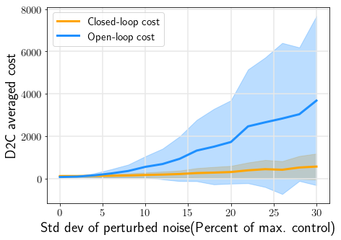
Cartpole
Batch=60
nonzero init=0.2
Averaged over 400
dt=0.01s
Closedloop vs openloop
Sysid Pert_noise=0.5umax
Sysid trial_num=200
Measurement noise=N(0,0.1)

Slide 40
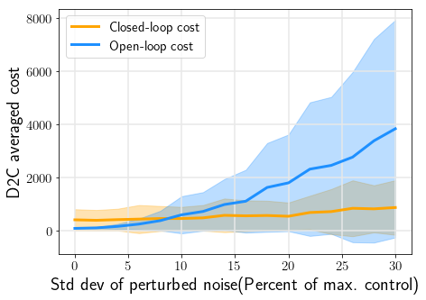
Cartpole
Batch=60
nonzero init=0.2
Averaged over 400
dt=0.01s
Closedloop vs openloop
Sysid Pert_noise=0.5umax
Sysid trial_num=200
Measurement noise=N(0,0.3)

Slide 41

Cartpole
Batch=60
nonzero init
Averaged over 400
dt=0.01s
Closedloop vs openloop
Sysid Pert_noise=0.8umax
Sysid trialnum=2000

Slide 42
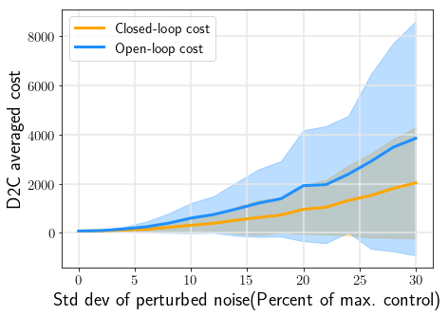
Cartpole
Batch=60
zero init
Matchq=4(all not mentioned were 8)
Averaged over 400
dt=0.01s
Closedloop vs openloop
Sysid Pert_noise=0.12umax

Slide 43
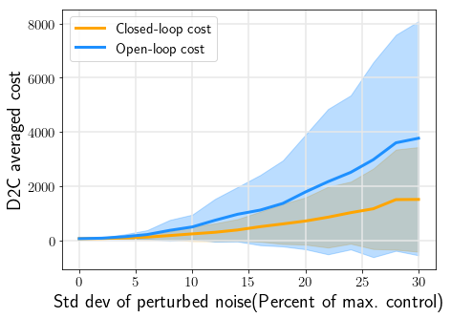
Cartpole
Batch=60
nonzero init
Matchq=8
Averaged over 400
dt=0.01s
Closedloop vs openloop
Sysid Pert_noise=0.8umax
Sysid trail_num=200

Slide 44
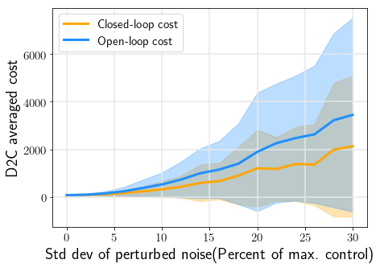
Cartpole
Batch=60
nonzero init
Matchq=8
Averaged over 400
dt=0.01s
Closedloop vs openloop
Sysid Pert_noise=0.8umax
Sysid trail_num=200

Slide 45

Cartpole
Batch=60
nonzero init
Matchq=8
Averaged over 400
dt=0.01s
Closedloop vs openloop
Sysid Pert_noise=0.12umax
Sysid trail_num=200

Slide 46


swimmer3
Batch=770
Init=0
Matchq=10
Averaged over 400
dt=0.005s
Closedloop vs openloop
Sysid Pert_noise=0.05umax
Sysid trail_num=3000

Slide 47

swimmer3
Batch=520
Init=0
Matchq=10
Averaged over 400
dt=0.005s
Closedloop vs openloop
Sysid Pert_noise=0.02umax
Sysid trail_num=3000

Slide 48


swimmer3
Batch=200
Init=0.01
Matchq=10
Averaged over 400
dt=0.005s
Closedloop vs openloop
Sysid Pert_noise=0.02umax
Sysid trail_num=3000

Slide 49

swimmer3
Batch=155
Init=0.01
Matchq=10
Averaged over 400
dt=0.005s
Closedloop vs openloop
Sysid Pert_noise=0.02umax
Sysid trail_num=10000

Slide 50

swimmer3
Batch=155
Init=0.01
Matchq=10
Averaged over 400
dt=0.005s
Closedloop vs openloop
Sysid Pert_noise=0.04umax
Sysid trail_num=10000

Slide 51

swimmer3
Batch=155
Init=0
Matchq=10
Averaged over 400
dt=0.005s
Closedloop vs openloop
Sysid Pert_noise=0.04umax
Sysid trail_num=10000

Slide 52

swimmer3
Batch=155
Init=0.01
Matchq=10
Averaged over 400
dt=0.005s
Closedloop vs openloop
Sysid Pert_noise=0.04umax
Sysid trail_num=10000
Measurement noise N(0,2)

Slide 53

cartpole
Batch=60
Init=0.02
Matchq=4
dt=0.01s
Sim vs qmc
Sysid Pert_noise=0.5umax
Sysid trail_num=2000
Only velocity

Slide 54

cartpole
Batch=60
Init=0.02
Matchq=4dt=0.01s
Closedloop vs openloop
Sysid Pert_noise=0.5umax
Sysid trail_num=2000
Only velocity

Slide 55

Input output fitting
Linear TV

Slide 56





Input output fitting
Q=4
Qu=4
100 steps
100 rollouts

Slide 57


Input output fitting
Q=4
Qu=4
100 steps
100 rollouts

Slide 58

Input output fitting
Q=4
Qu=4
300 steps
100 rollouts
Doesn’t work
Q=4
Qu=4
300 steps
1000 rollouts
Still doesn’t work
The state error builds up gradually

Slide 59


Input output fitting
Q=1
Qu=1
300 steps
100 rollouts
Q=2
Qu=2
300 steps
100 rollouts

Slide 60


Input output fitting
Q=3
Qu=3
300 steps
100 rollouts
Q=4
Qu=1
300 steps
100 rollouts

Slide 61


Input output fitting
Q=8
Qu=1
300 steps
100 rollouts
higher q break
Q=1
Qu=4
300 steps
100 rollouts
higher qu still work,tested qu=8

Slide 62



Input output fitting
Q=8
Qu=1
300 steps
100 rollouts
Q=8, qu=4 doesn’t work
Q=4
Qu=4
300 steps
100 rollouts

Slide 63



Input output fitting another partial observable sys
Q=4
Qu=4
100 steps
100 rollouts

Slide 64



Input output fitting another partial observable sys
fitcoef
Q=1
Qu=1
300 steps
100 rollouts

Slide 65


q=qu=3: Zk+1=a1*Zk-2+b1*Uk+b2*Uk-1+b3*Uk-2
fitcoef

Slide 66




LTI
Qx=qu=1

Slide 67




LTI
Qx=1
Qu=3

Slide 68



LTI
Qx=1
Qu=1
C invertible

Slide 69

LTV
Qx=2
Qu=1
C not invertible
2 states 1 output
Larger Qii for u

Slide 70

LTV
Qx=2
Qu=1
C not invertible
2 states 1 output
Larger Qii for u

Slide 71

LTV
Qx=2
Qu=1
C not invertible
same Qii for u and z

Slide 72


LTV| Qx=1| Qu=1 |C not invertible 1 output 2 states,C=[1 0.2]
LTV| Qx=2| Qu=1 |C not invertible

Slide 73


LTV| Qx=3| Qu=1 |C not invertible
LTV| Qx=2| Qu=2 |C not invertible

Slide 74

LTV| Qx=1| Qu=1 |C invertible 2 outputs
LTV| Qx=2| Qu=1 |C invertible
Least square is singular

Slide 75


LTV| Qx=1| Qu=1 |C not invertible 1 output 3 states; qu=2:better prediction
LTV| Qx=2| Qu=1 |C not invertible; qu=2: better prediction; [C;CA;CAA] full c rank; q>2,lqr fails

Slide 76

LTV| Qx=1| Qu=1 |C invertible 3 outputs 3 states

Slide 77


Pendulum
200 steps
C invertible
Q=qu=1

Slide 78


Pendulum
200 steps
C invertible
Q=1
qu=2

Slide 79


Pendulum
200 steps
C invertible
Q=2
qu=1
Least square singular
Pendulum
200 steps
C invertible
Q=2
qu=2
Least square singular

Slide 80


Pendulum
200 steps
C not invertible
Q=1
qu=1

Slide 81


Pendulum
200 steps
C not invertible
Q=1
qu=2

Slide 82


Pendulum
200 steps
C not invertible
Q=2
qu=1

Slide 83

Pendulum
200 steps
C not invertible
Q=2
qu=2 helps prediction but lqr fails

Slide 84


Pendulum
200 steps
C not invertible
Q=3
qu=1

Slide 85

Pendulum
200 steps
C not invertible
Q=3
qu=2

Slide 86

cartpole
300 steps
C invertible
Q=1 qu=1
Similar results for Q=1,qu=2
Lqr failed when q=1, qu=3
cartpole
300 steps
C invertible
Q>1, singular matrix in least square

Slide 87




cartpole
300 steps
C 1 by 4
Q=1 qu=1
Similar results for Q=1,qu=2,qu=3
Lqr failed when q=1, qu=4
cartpole
300 steps
C 1 by 4
Q=2, qu=1
Similar results for Q=2,qu=2
Further increase qu, lqr becomes worse

Slide 88


cartpole
300 steps
C 1 by 4
Q=3 qu=1
Lqr failed when qu=2
cartpole
300 steps
C 1 by 4
Q>3 lqr fails,
No singular warning

Slide 89




LTI pendulum downright position| Qx=1| Qu=1 |C invertible 2 output 2 states,C=I vs C not identity
LTI pendulum downright position| Qx=1| Qu=2vs4 |C invertible 2 output 2 states,C=I

Slide 90




LTI pendulum downright position| Qx=2| Qu=1vs2 |C invertible 2 output 2 states,C=I,qx and qu >2, lqr also bad,LS singular
LTI pendulum downright position| Qx=1| Qu=1 |C invertible 2 output 2 states,C=I,Qii for Zk only vs Qii for all

Slide 91




LTI pendulum downright position| Qx=1| Qu=1vs2 |C =[1,0.6] [C;CA] full col rank |1 output 2 states, qu>2, lqr becomes bad
LTI pendulum downright position| Qx=2| Qu=1vs2 | C =[1,0.6] [C;CA] full col rank | 1 output 2 states

Slide 92





LTI pendulum downright position| Qx=2| Qu=4 |C =[1,0.6] [C;CA] full col rank |1 output 2 states, increase qu, prediction ok but lqr becomes bad
LTI pendulum downright position| Qx=3| Qu=1vs2 | C =[1,0.6] [C;CA] full col rank | 1 output 2 states|increase qu, lqr fail

Slide 93





LTI pendulum downright position| Qx=1| Qu=1vs2 |C =[1,0] [C;CA] full col rank |1 output 2 states, qu>2, lqr becomes bad
LTI pendulum downright position| Qx=2| Qu=1vs2 | C =[1,0] [C;CA] full col rank | 1 output 2 states|increase qu,prediction ok but lqr fail

Slide 94



LTI pendulum downright position| Qx=2| Qu=4 |C =[1,0] [C;CA] full col rank |1 output 2 states, increase qu, prediction ok but lqr becomes bad
LTI pendulum downright position| Qx=3| Qu=1vs2 | C =[1,0] [C;CA] full col rank | 1 output 2 states|increase qu, prediction good but lqr fail

Slide 95




LTI pendulum downright position| Qx=1| Qu=1vs2 |C =[0,1] [C;CA] full col rank |1 output 2 states, qu>2, lqr becomes bad
LTI pendulum downright position| Qx=2| Qu=1vs2 | C =[0,1] [C;CA] full col rank | 1 output 2 states|increase qu,prediction ok but lqr fail

Slide 96



LTI pendulum downright position| Qx=2| Qu=4 |C =[0,1] [C;CA] full col rank |1 output 2 states, increase qu, prediction ok but lqr becomes bad
LTI pendulum downright position| Qx=3| Qu=1,2 similar | C =[0,1] [C;CA] full col rank | 1 output 2 states|increase qu, prediction good but lqr fail

Slide 97



LTI cartpole downright position| Qx=1| Qu=1vs2 |C=I|4 output 4 states, qu>2, lqr becomes bad
LTI cartpole downright position| Qx=1| Qu=4 | C =I| 4 output 4 states|increase qu,prediction ok but lqr fail

Slide 98

LTI cartpole downright position| Qx=2|qu=1,2,3,6|C invertible 4 output 4 states,C=I,qx and qu >2, lqr also bad,LS singular
LTI cartpole downright position| C invertible not I |4 output 4 states, similar results| Qii for Zk better than Qii for all

Slide 99


LTI cartpole downright position| Qx=1| Qu=1,2 |C only observe 2 pos|[C;CA] full col rank |2 output 4 states, qu>2, similar, no warning
LTI cartpole downright position| Qx=2| Qu=1,2 | C only observe 2 pos|[C;CA] full col rank | 2 output 4 states

Slide 100



LTI cartpole downright position| Qx=1vs2| Qu=1,2 |C only observe 2 vel|O never full col rank |2 output 4 states, qu>2, similar, no warning
LTI cartpole downright position| Qx=3| Qu=1,2,3,4 | C only observe 2 vel|O never full col rank | 2 output 4 states,lqr fails|for q>3 prediction and lqr fail

Slide 101



LTI cartpole downright position| Qx=1| Qu=1vs2 |C =[0.3 0.4 0.5 0.6]|q=4 O full col rank |1 output 4 states
LTI cartpole downright position| Qx=2| Qu=1 |C =[0.3 0.4 0.5 0.6]|q=4 O full col rank |1 output 4 states, qu>2, lqr fails|q>=3, prediction OK but lqr fails, no warning

Slide 102

Q=4,qu=3

Slide 103




LTI | Qx=1| Qu=1vs2 |C=I|3 output 3 states, qu>2, lqr worse，prediction perfect
LTI | Qx=2,3| qu=1,2…|C=I|3 output 3 states,lqr bad，prediction perfect|increase qx, qu, prediction and lqr fail

Slide 104




LTI | Qx=1| Qu=1vs4 |C=[1 0 0]|q=3 O full col rank|1 output 3 states, qu>2, lqr bad，prediction better|same for qx=2,3,4
LTI | similar results for C=[1 2 1]|q=3 O full col rank |1 output 3 states
LTI | similar results for C=[1 0 0;0 1 0]|q=2 O full col rank |2 output 3 states

Slide 105




LTI | Qx=1| Qu=1vs4 |C=[1 0 0;0 0 1]|q=2 O full col rank|2 output 3 states, qu>2, lqr bad，prediction better
LTI | Qx>1| all Qu|C=[1 0 0;0 0 1]|q=2 O full col rank|2 output 3 states|lqr bad，prediction perfect|
Qx=1,qu=2
LTI | similar results for C=[1 0 0;0 1 1]|q=2 O full col rank |2 output 3 states

Slide 106

Pendulum lti unstable only vel q=2 qu=1

Slide 107

Pendulum lti stable only vel q=2 qu=2

Slide 108

Pendulum nonlinear only vel q=2 qu=2

Slide 109

CARTPOLE lti stable only vel q=2 qu=2

Slide 110

CARTPOLE nonlinear only vel q=2 qu=1

Slide 111


Lqg nonzero init noiseless
Only pos
pendulum
Lqg nonzero init noiseless
Only vel
pendulum

Slide 112



Lqg zero init
Process&measurement noise pendulum
Fully observable
Only vel
Only pos

Slide 113



Lqg zero init
Process&measurement noise cartpole
Fully observable
Only vel
Only pos

Slide 114




Swimmer3 full
Q=qu=1
Swimmer3 only pos
Q=qu=2

Slide 115

Swimmer3 only pos
Q=qu=2

Slide 116



Swimmer3 full
Q=qu=1
Swimmer3 only pos Q=qu=2

Slide 117

Swimmer6 only pos Q=qu=2

Slide 118


Fish full
Q=qu=1
10% noise
Fish only pos
Q=qu=2
40% noise
Only torso xyz and quaternions | q=qu=2,3,4,5 | id ok, closedloop fails
Only torso xyz and quaternions + torso vel | q=qu=2,3,4,5 | id fail, closedloop fails

Slide 119

Fish only fin pos
Q=qu=2
20% noise

Slide 120

Swimmer15
Theta 1,3,5,7,9,11,13,15
Q=qu=5
20% noise

Slide 121

T2D1 3D
8 nodes pos
Q=qu=3
20% noise

Slide 122

T2D1 3D
all nodes pos
Q=qu=2
20% noise

Slide 123

T2D1 3D
all nodes pos
Q=qu=2
20% pnoise lqg

Slide 124

dbar3d
All pos only，q=qu=2

Slide 125

T1d13d

Slide 126

swimmer15

Slide 127

swimmer6

Slide 128

swimmer3

Slide 129

pendulum

Slide 130

cartpole

Slide 131

T2D1 3D

Slide 132

Fish

Slide 133

Fish
Fin pos
Q=qu=2

Slide 134

LQG

Slide 135


Cartpole

Slide 136



s15

Slide 137



fish

Slide 138


T2d1

Slide 139

cartpole

Slide 140

fish

Slide 141

s15

Slide 142

t2d1

Slide 143

t2d1

